Slide 1

Hymns and prayers
Church Action on Poverty Sunday
19 October 2025

Slide 2
The Church Action on Poverty Sunday prayer
As we wrestle with our realities,
frustrated by policies based on injustice,
disillusioned by decisions made by greed, structures grown on inequality,
We will not let you go before you bless us
Until we can say that we too have struggled with God and with humans and have overcome.
Our struggle is your struggle. Let your dreams become our reality.
Revd Dr Urzula Glienecke

Slide 3
Gather: opening responses
Loving God, we come to you with our dreams
We come to you with our struggles
We come to you with our hopes
We come to you with our reality
Walk beside us,
Fight alongside us
As we strive to end poverty in our country
In the name of God the Father who lifts up the lowly
In the name of Jesus Christ who knew what poverty is like
And the Holy Spirit who empowers us all
to change the world step by step
Amen
Revd Dr Urzula Glienecke

Slide 4
Pray: intercessions (1)
Let us pray for those whose dreams are constrained by a reality affected by poverty, injustice, anxiety and struggle and who yearn for a world where they can imagine new possibilities and have hope for their families.
As we trust God to be with them, we pray that they can experience that presence through the actions of others who walk with them, the words of others who speak with them, and the love of others who stay with them when it feels too much.
We ask this in your name
Amen

Slide 5
Pray: intercessions (2)
Let us pray for ourselves, in churches and faith communities, struggling with the realities of poverty and injustice, or worried for others who are. May we be inspired by God’s promise of a new covenant to find the courage and belief to speak out for the possibilities of a new way of being.
We pray for our church leaders, that they be filled with hope and resilience to speak truth to power, and the resilience to keep trying when others appear to turn away.
We ask this in your name
Amen

Slide 6
Pray: intercessions (3)
Let us pray for our political leaders, for those in power and for others who want to be, that they may be filled with wisdom and understanding, to recognise the effect and impact of policies and politics, on the lives of people today and in the future.
We pray that their hearts are softened and minds are opened so they may be inspired by the dreams of those who have little, rather than influenced by those who have too much.
We ask this in your name
Amen

Slide 7
Pray: intercessions (4)
Let us pray for persistence, for ourselves and all who need it as we strive for a more just and equitable world. We ask for the grace to be like the tenacious widow, challenging all in our world who show disregard and lack of care for the troubles of others.
We pray for the faith of the widow, to keep asking and campaigning, regardless of the response, and to trust in God’s promise of a world where neighbour will care for neighbour and all will have enough.
We ask this in your name
Amen

Slide 8
Pray: intercessions (5)
We pray for ourselves, and all who work for a better world, at this time of turmoil, conflict and struggle that we may be inspired and nourished by your scripture and its message to us, and not be disheartened no matter how difficult life feels.
We pray for hope and strength, to take up our mission in the world and be voices for truth, justice and love in the face of indifference and contradiction and find the ability to trust in God and dream again.
We ask this in your name
Amen
Miriam McHardy

Slide 9
Send out
Jesus stands among his followers, when they are gathered together.
He leaves them his peace and his Spirit.
Do not be afraid.
May your dreams and visions be bold enough to see his Kingdom,
and may his Spirit strengthen you to build it.
Amen
Revd Marie Pattison

Slide 10
Justice hymn (1)
Tune: Alleluia Dulce Carmen (8,7,8,7,8,7)
How to live in peace and fairness,
God, you taught in ancient law.
Jesus showed us love in action -
challenges for rich and poor,
reinforced by tales of wisdom,
parables we can’t ignore.

Slide 11
Justice hymn (2)
We recall the troubled widow
in the story Jesus told:
she demanded compensation
from the judge in words so bold.
If we do not lose our courage,
will true righteousness unfold?

Slide 12
Justice hymn (3)
In a world of greed and suffering
can real justice still be found?
Rich men think they can’t be questioned;
poor survive on their last pound.
Can we make the call to fairness
echo through the world around?

Slide 13
Justice hymn (4)
Where good laws are still perverted,
might is right and money reigns,
we must never cease from struggle,
cleansing all our social stains.
God, we ask that love for justice
may run deeply in our veins.
Revd Nick Jowett, June 2025

Slide 14
We are loved (1)
Lyrics, chords, recording and CCLI information at unifiedpraise.com/songs/477-we-are-loved
If we are lost in the valley’s shadow,
If we lose hope, and all around is grey.
If we can’t see the Lord who walks beside us,
Who guards our hearts and keeps our feet upon the Way,
There is a voice that speaks louder than our fears.
There is a grace that whispers through our tears,
There is a hope, let sorrow disappear;
For we are loved.

Slide 15
We are loved (2)
Lyrics, chords, recording and CCLI information at unifiedpraise.com/songs/477-we-are-loved
We have a God who teaches us our value
And Christ our Lord who shows us sacrifice,
The Holy Ghost who comforts and befriends us,
And helps us see the whole creation through God’s eyes.
Teach us to love, for love fulfils your law.
Teach us to care; make dignity our goal,
And as we serve, let “Justice!” be our cry,
For we are loved!
© 2025 Andrew Clayton

Slide 16
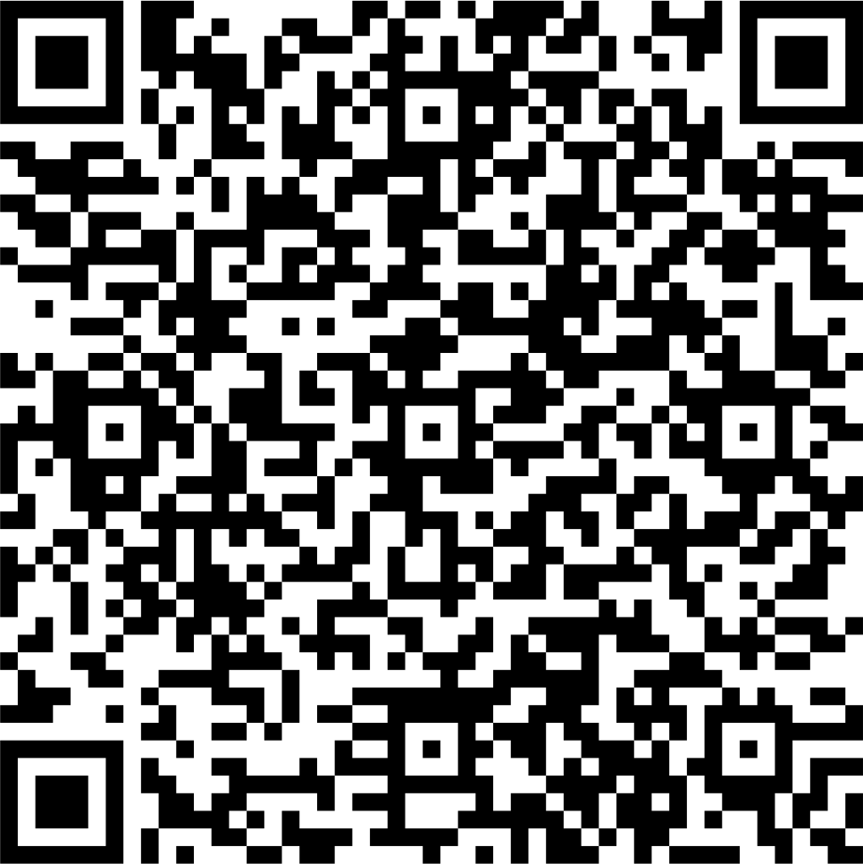
Give
£10 is enough to produce a resource pack to help a local church reflect and take action on poverty
£25 is enough to pay for somebody experiencing poverty to share their story as a video online
£50 could help train a person in poverty to engage with the media or become a community leader
Scan the code with your phone
or visit
www.church-poverty.org.uk/sunday/give
to make a secure online donation
to Church Action on Poverty

