Slide 1

Hymns and prayers
Church Action on Poverty Sunday
2 March 2025

Slide 2
The Church Action on Poverty Sunday prayer
God of grace,
you speak to us in dreams of hope and encouragement.
In Jesus you created communities of acceptance and healing,
where all might flourish.
May your Spirit urge us to turn the dreams you still send
into the reality of a new world
where everyone can fulfil the gifts of their life.
For Jesus Christ’s sake.
Nick Jowett

Slide 3
A confession (1)
God of mercy, we confess to you that our society lives by an untruth that sounds like encouragement and hope, yet is not.
It is the lie that freedom and opportunity are really within everyone’s reach.
But in a world of inequality,
where the poor do not have the means for healthy food,
where their health services are stretched beyond the limit,
where their schools struggle for resources,
where their libraries and swimming pools have closed
and where there are no youth centres or parks,
in such a world the idea that any poor person could, with a little personal effort, easily rise to success and self-fulfilment –
this is the lie.
(continues…)

Slide 4
A confession (2)
Forgive us when we fall back on this untruth.
For we remember that Jesus so often gave a gift
before making the challenge to change.
Help us to will the resources for the wellbeing of every person,
so that all may truly gain the potential for fullness of life.
We pray in Jesus’ name.
Nick Jowett

Slide 5
Kyrie confession
In a society where the wellbeing of many
is sacrificed for quick profit for the few
Lord, have mercy.
Lord, have mercy.
In a country of conveniences and luxuries
where many of our children are hungry
Christ, have mercy.
Christ, have mercy.
In a time when our worth is measured by wealth
not the richness of the dreams in our hearts
Lord, have mercy.
Lord, have mercy.
Marie Pattison

Slide 6
The Gate of Heaven
It can’t have been a very big stone,
If Jacob could use it as a pillow.
There must have been hundreds like it;
^{A very ordinary stone}
^{In a barren place.}
Yet it was where the kingdoms of earth and heaven met,
And a dream contained a promise
^{Which became a reality.}
^{Such places still exist;}
^{Barren, ordinary,}
But where the hidden yeast of the kingdom of Heaven
^{Is at work,}
^{And dreams of justice, mercy,}
^{Help for the vulnerable,}
^{Care for the weak,}
^{Banquets for the hungry,}
^{Abundance for the poor}
^{Hope for the oppressed,}
^{Are becoming reality.}
^{Brian Ford}

Slide 7
Just a Teenage Peasant Girl
^{Just a teenage peasant girl,}
^{Probably illiterate,}
But claiming that all generations would call her blessed.
^{That, at least, has happened.}
She also claimed that the proud would be scattered,
^{Rulers brought down,}
^{The rich sent empty away,}
^{The humble lifted up}
^{And the hungry filled.}
^{Lord, may we who are proud}
Allow our smug arrogance to be scattered,
And use our wealth for the humble and poor,
So that part of her song, her vision
^{Also happens.}
^{Brian Ford}

Slide 8
Intercessions (1)
We pray to our heavenly Father for all those in our world who are held back by the bitter injustice of our society from fulfilling their hopes and their dreams.
Father, turn their dreams into new realities.
We pray for artists and musicians, held back from fulfilling their gifts by lack of support or resources.
Father, turn their dreams into new realities.
We pray for carers, frustrated by poor public transport, and unable to do all they would like for their families.
Father, turn their dreams into new realities.
We pray for refugees and people seeking sanctuary, forced to live in limbo, unable to move onwards in their lives.
Father, turn their dreams into new realities.
^{(Continues…)}

Slide 9
Intercessions (2)
We pray for health professionals from many parts of the world struggling to gain the qualifications necessary for their future careers.
Father, turn their dreams into new realities.
We pray for those who are forced out of their homes, lost in a nightmare of homelessness and unable to plan ahead for their lives.
Father, turn their dreams into new realities.
We pray for those whose way is barred by the racist prejudice of their society.
Father, turn their dreams into new realities.
We pray for those who long to offer a helping hand to those still suffering the effects of poverty, addiction or mental ill health but lack the resources or qualifications to do so.
Father, turn their dreams into new realities.
^{(Continues…)}

Slide 10
Intercessions (3)
We pray for those who are themselves poor and yet suffer as victims of robbery, fraud or violence.
Father, turn their dreams into new realities.
Heavenly Father, we ask that together, we may change our common life so that more people can throw off the shackles of poverty and deprivation, and so turn their dreams into realities of new, good life.
Father, turn our dreams into new realities.
We ask these prayers in the name of the one who came to bring a new reality to those who longed for it, Jesus Christ our Lord.
^{Nick Jowett}

Slide 11
Send out
Have someone open the church doors and the people face them:
We go out into a world where many are hungry
^{Help us bring justice}
We go out into a world where many are hurting
^{Help us bring healing}
We got out into a world where many are yearning
^{Help us bring hope}
^{Marie Pattison}

Slide 12
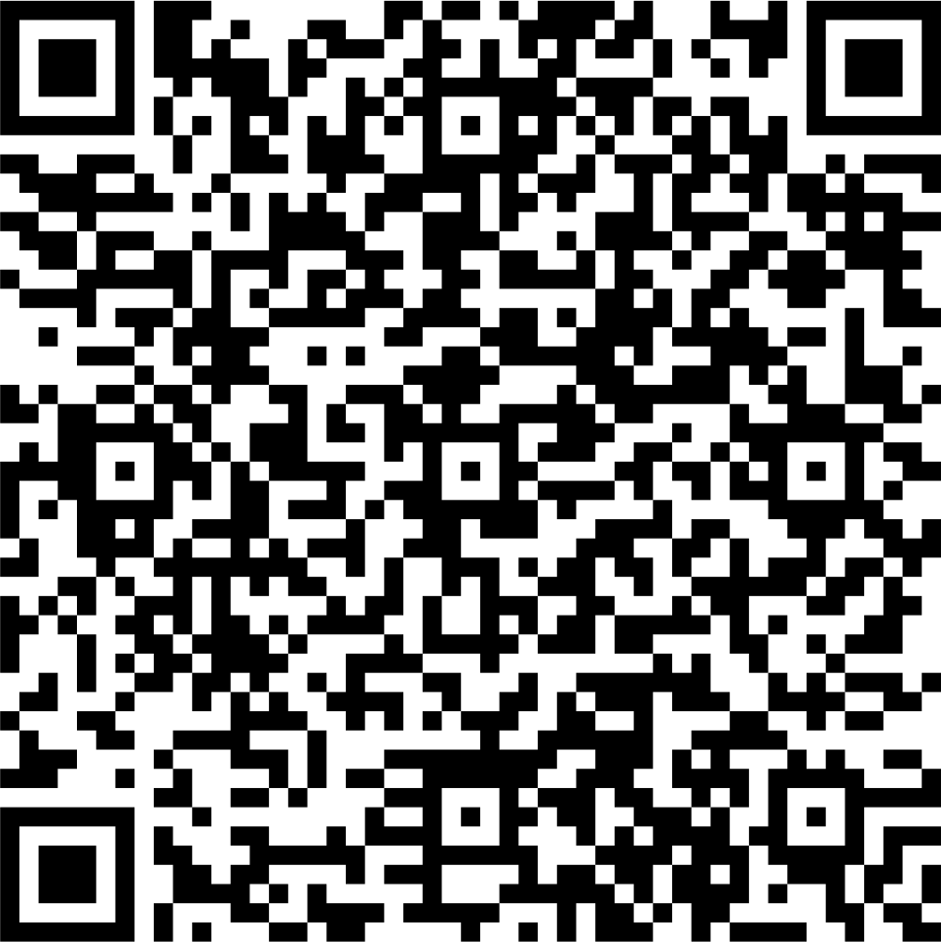
Give
£10 is enough to produce a resource pack to help a local church reflect and take action on poverty
£25 is enough to pay for somebody experiencing poverty to share their story as a video online
£50 could help train a person in poverty to engage with the media or become a community leader
Scan the code with your phone
or visit
www.church-poverty.org.uk/sunday/give
to make a secure online donation
to Church Action on Poverty

